Slide 1
Lab # 4

Slide 2
F [Fill]
The command fills a range of memory with a single value or a list of values.
Syntax: F range list
Example | Comment
F 100 500,’ ’ | Fill with spaces
F CS:300 1000,FF | Fill with hex 0FF
F 100 L 20 ‘A’ | Fill 20h bytes with the letter ‘A’, starting at location 100

Slide 3
P [Proceed]
Executes a loop, a repeated string instruction, a software interrupt, or a subroutine; or traces through any other instruction.
Example
A 100 mov cx, 5 ; loop counter = 5 mov ax, 0 Add, ax,cx Loop 106 ; loop to location 10b

Slide 4
S [Search]
Search a range of addresses for a list of bytes or a string.
Syntax: s range list
Example | Comment
S 100 1000 0D | Search DS:100 to DS:1000 for the value 0Dh
S 100 9FFF “COPY” | Search for the word “COPY”

Slide 5
XCHG Instruction
Exchanges the contents of two registers.
Syntax: XCHG op1, op2
Example:
  xchg ax, bx ;exchange BX with AX

Slide 6
Transfer of Control/Branch Instructions
A way of altering the order in which statements are executed.
Two Categories:
  Unconditional Transfer: The program branches to a new location in all cases. E.g. JMP instruction
  Conditional Transfer: The program branches if a certain condition is true. E.g. Loop instruction.

Slide 7
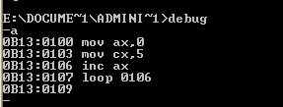
LOOP Instruction
LOOP instruction provides a simple way to repeat a block of statements a specific number of times.
CX is automatically used as a counter and is decremented each time the loop repeats.
Termination Condition: CX =0
Example:

Slide 8
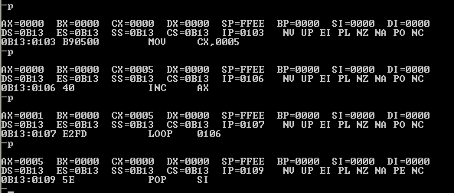
Contd..

Slide 9
JMP Instruction
The JMP instruction causes an unconditional transfer to the target location inside the code segment.
The location must be indentified by a code label.
JMP targetlabel

Slide 10
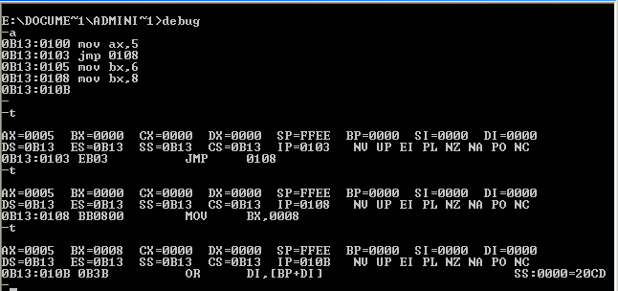
Contd..

